Slide 1
SQL Crash Course
Hosted by: Engineering Service Learning
Presented by: Eduardo Hernandez

Slide 2
Learning Goals and Outcomes
Learning more complex concepts like joining and aggregates

Slide 3
Advanced Queries
How many employees don’t live in Arizona?
What’s the sum of every employees’ ages?
What city do the most employees live in?
What’s the name of the oldest employee?

Slide 4
Aggregates
Select SUM(attribute)
Select AVG(attribute)
Select COUNT(attribute)
Select MAX(attribute)
Select MIN(attribute)
Think of them as functions
Each aggregate will return a single number rather than a collection of rows

Slide 5
Joining
Select *
From table1, table2
Leads to a “cross-join” table

Slide 6
Cross Join Pseudocode
For row1 in table1
For row2 in table2
Print table1.row1 + table2.row2

Slide 7
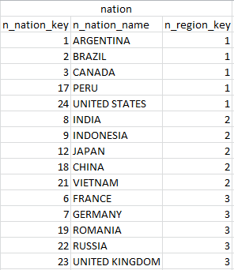
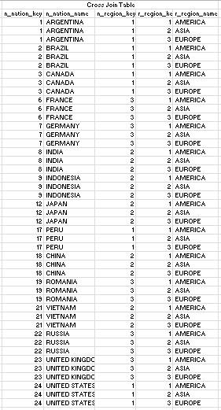
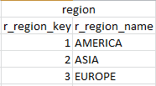
Cross Join Example

Slide 8
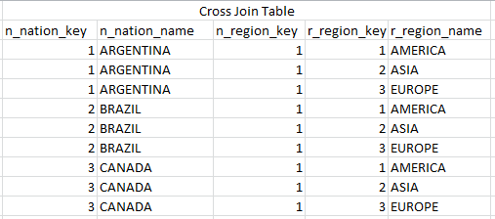
Cross Join Example

Slide 9
Joining
Select *
From table1, table2
Where table1.attr1 = table2.att2
Leads to a “inner-join” table

Slide 10
Inner Join Pseudocode
For row1 in table1
For row2 in table2
If (table1.row1.att1 == table2.row2.att2)
Print table1.row1 + table2.row2

Slide 11
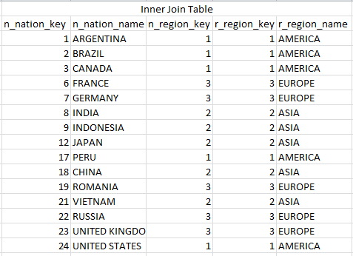
Inner Join Example

Slide 12

Different Kinds of Joins

Slide 13
Homework
What’s the most points a player scored in the regular season?
Which games did LeBron James achieve a “triple-double?”
How many times did Stephen Curry score more than 30 points in a row?

Slide 14
Resources
http://www.tutorialspoint.com/sql/
http://www.w3schools.com/sql/default.asp

